Slide 1
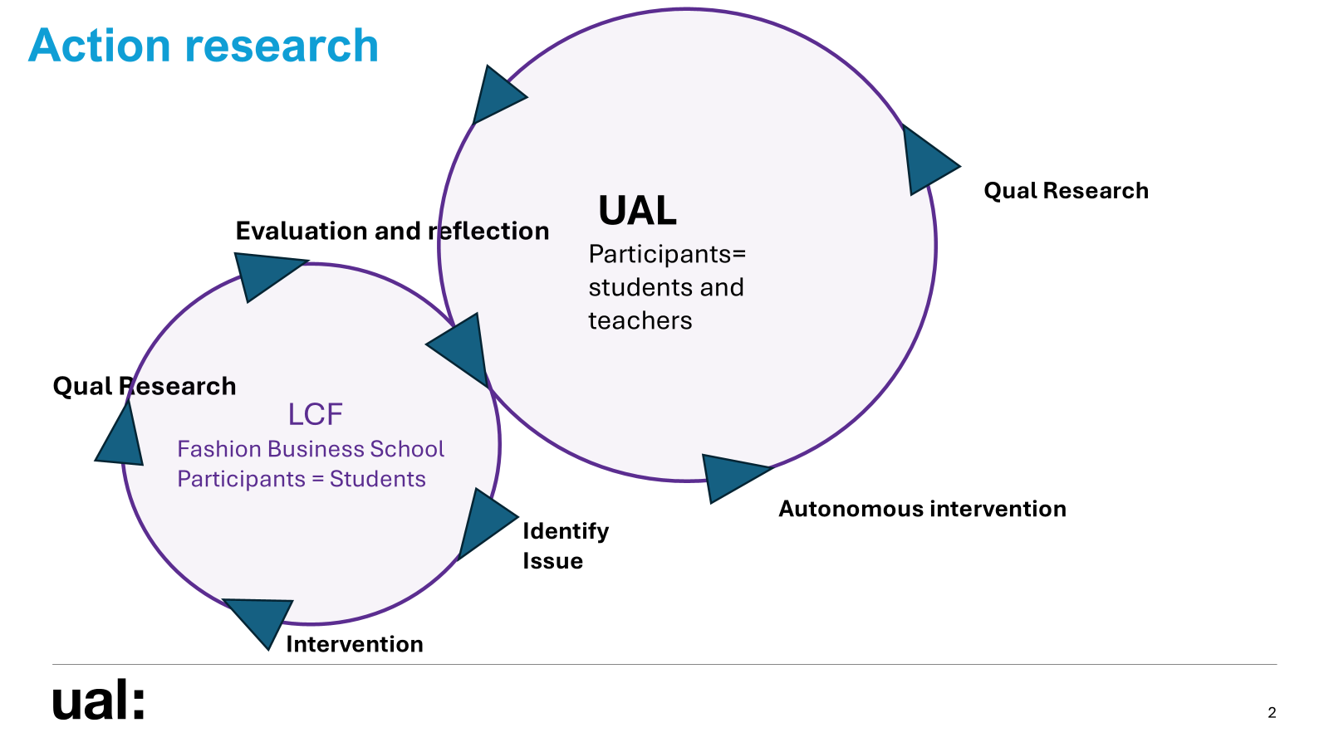
Thank you
Ian Holmes MSc BA (Hons) AFHEA
i.holmes@arts.ac.uk

