Slide 1
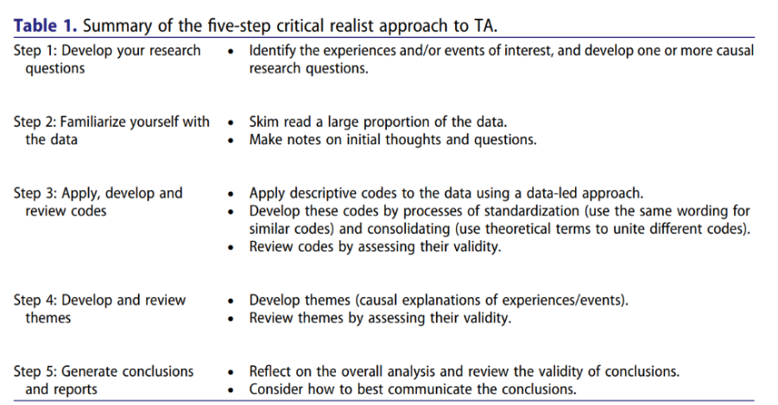
Thematic Analysis – A Critical Realist Approach
Fryer (2022, p. 366) offers a critical realist approach to Thematic Analysis that is appropriate for this project which ultimately ‘seeks to develop causal explanations.’
Compatible with Braun and Clarke (2020)
Familiarization with the Data
Generating Initial Codes
Searching for Themes
Reviewing Themes
Defining and Naming Themes
Writing the Report
Critical realism aspect

