Slide 1
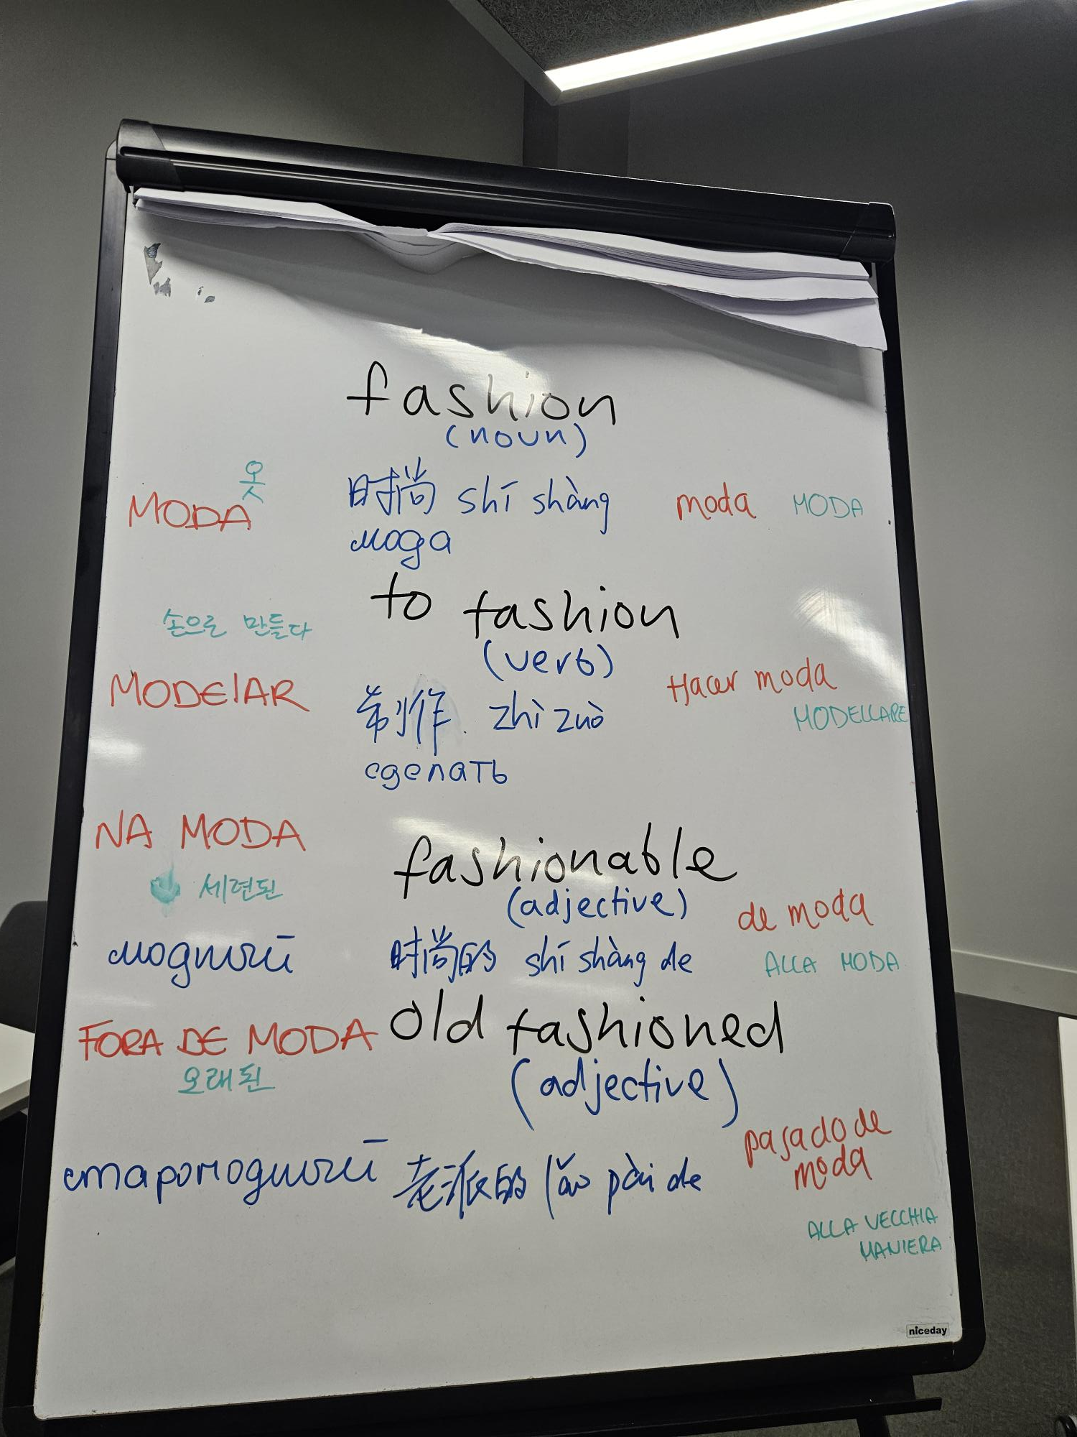
Making languages visible in the Language
Development
Space
Action Research Project
PG Cert 2025- 26
LO1

Slide 2
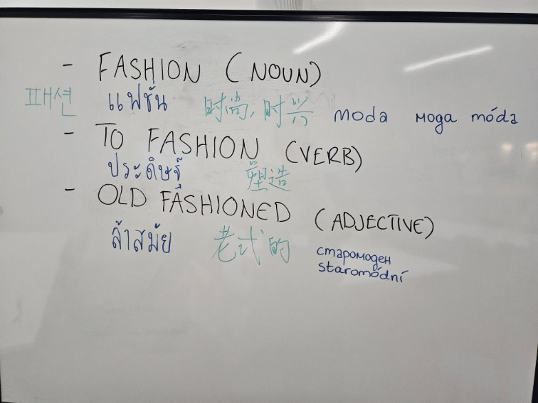
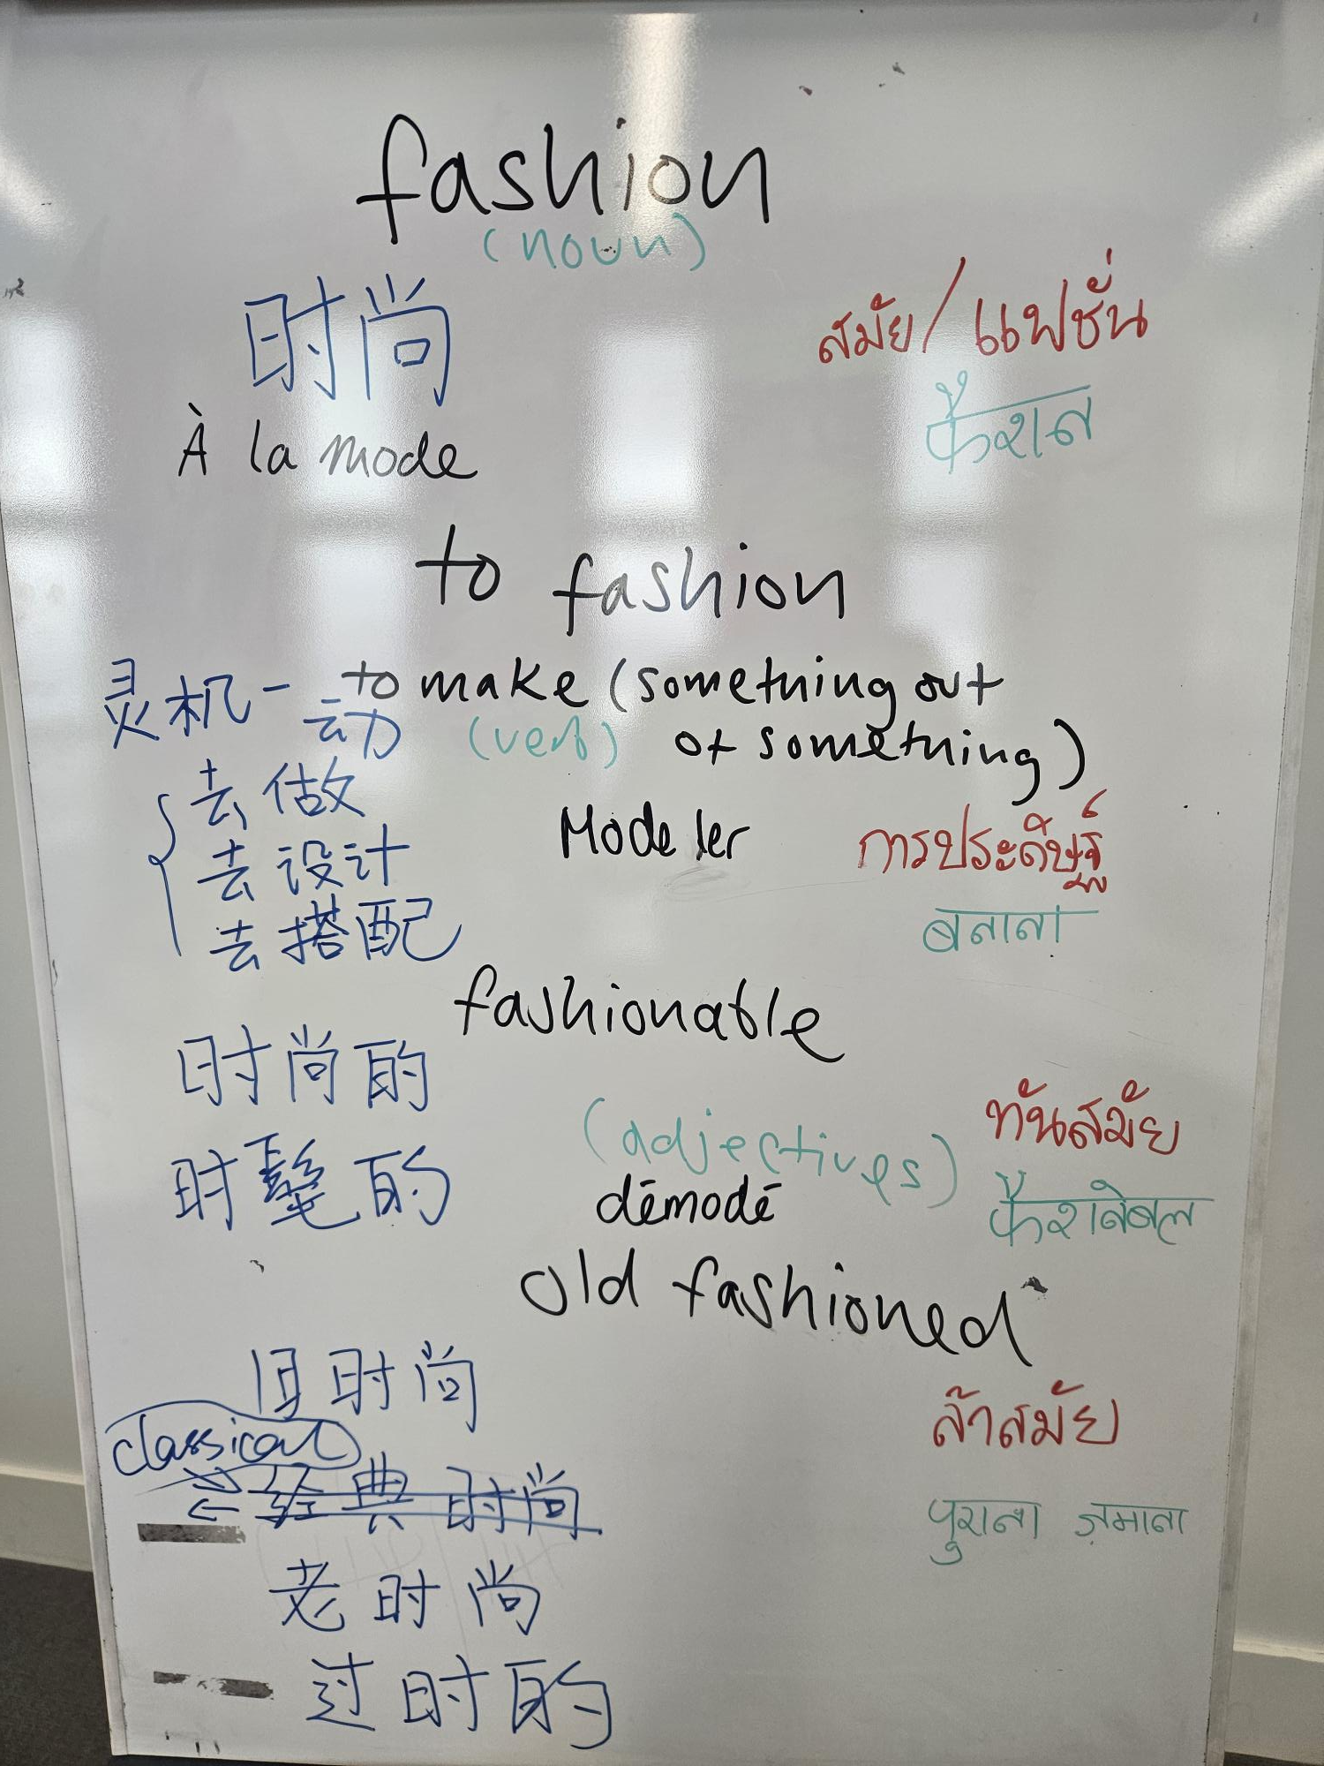
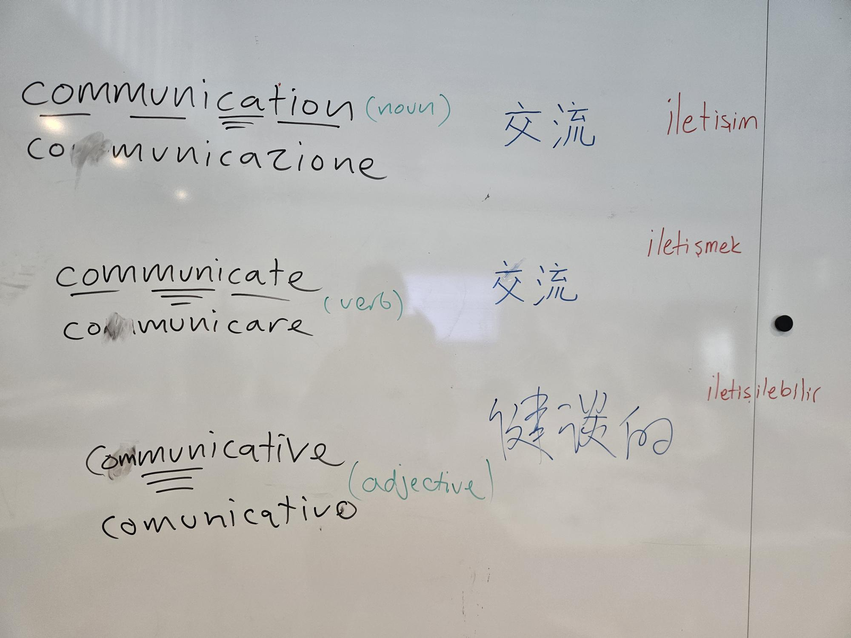
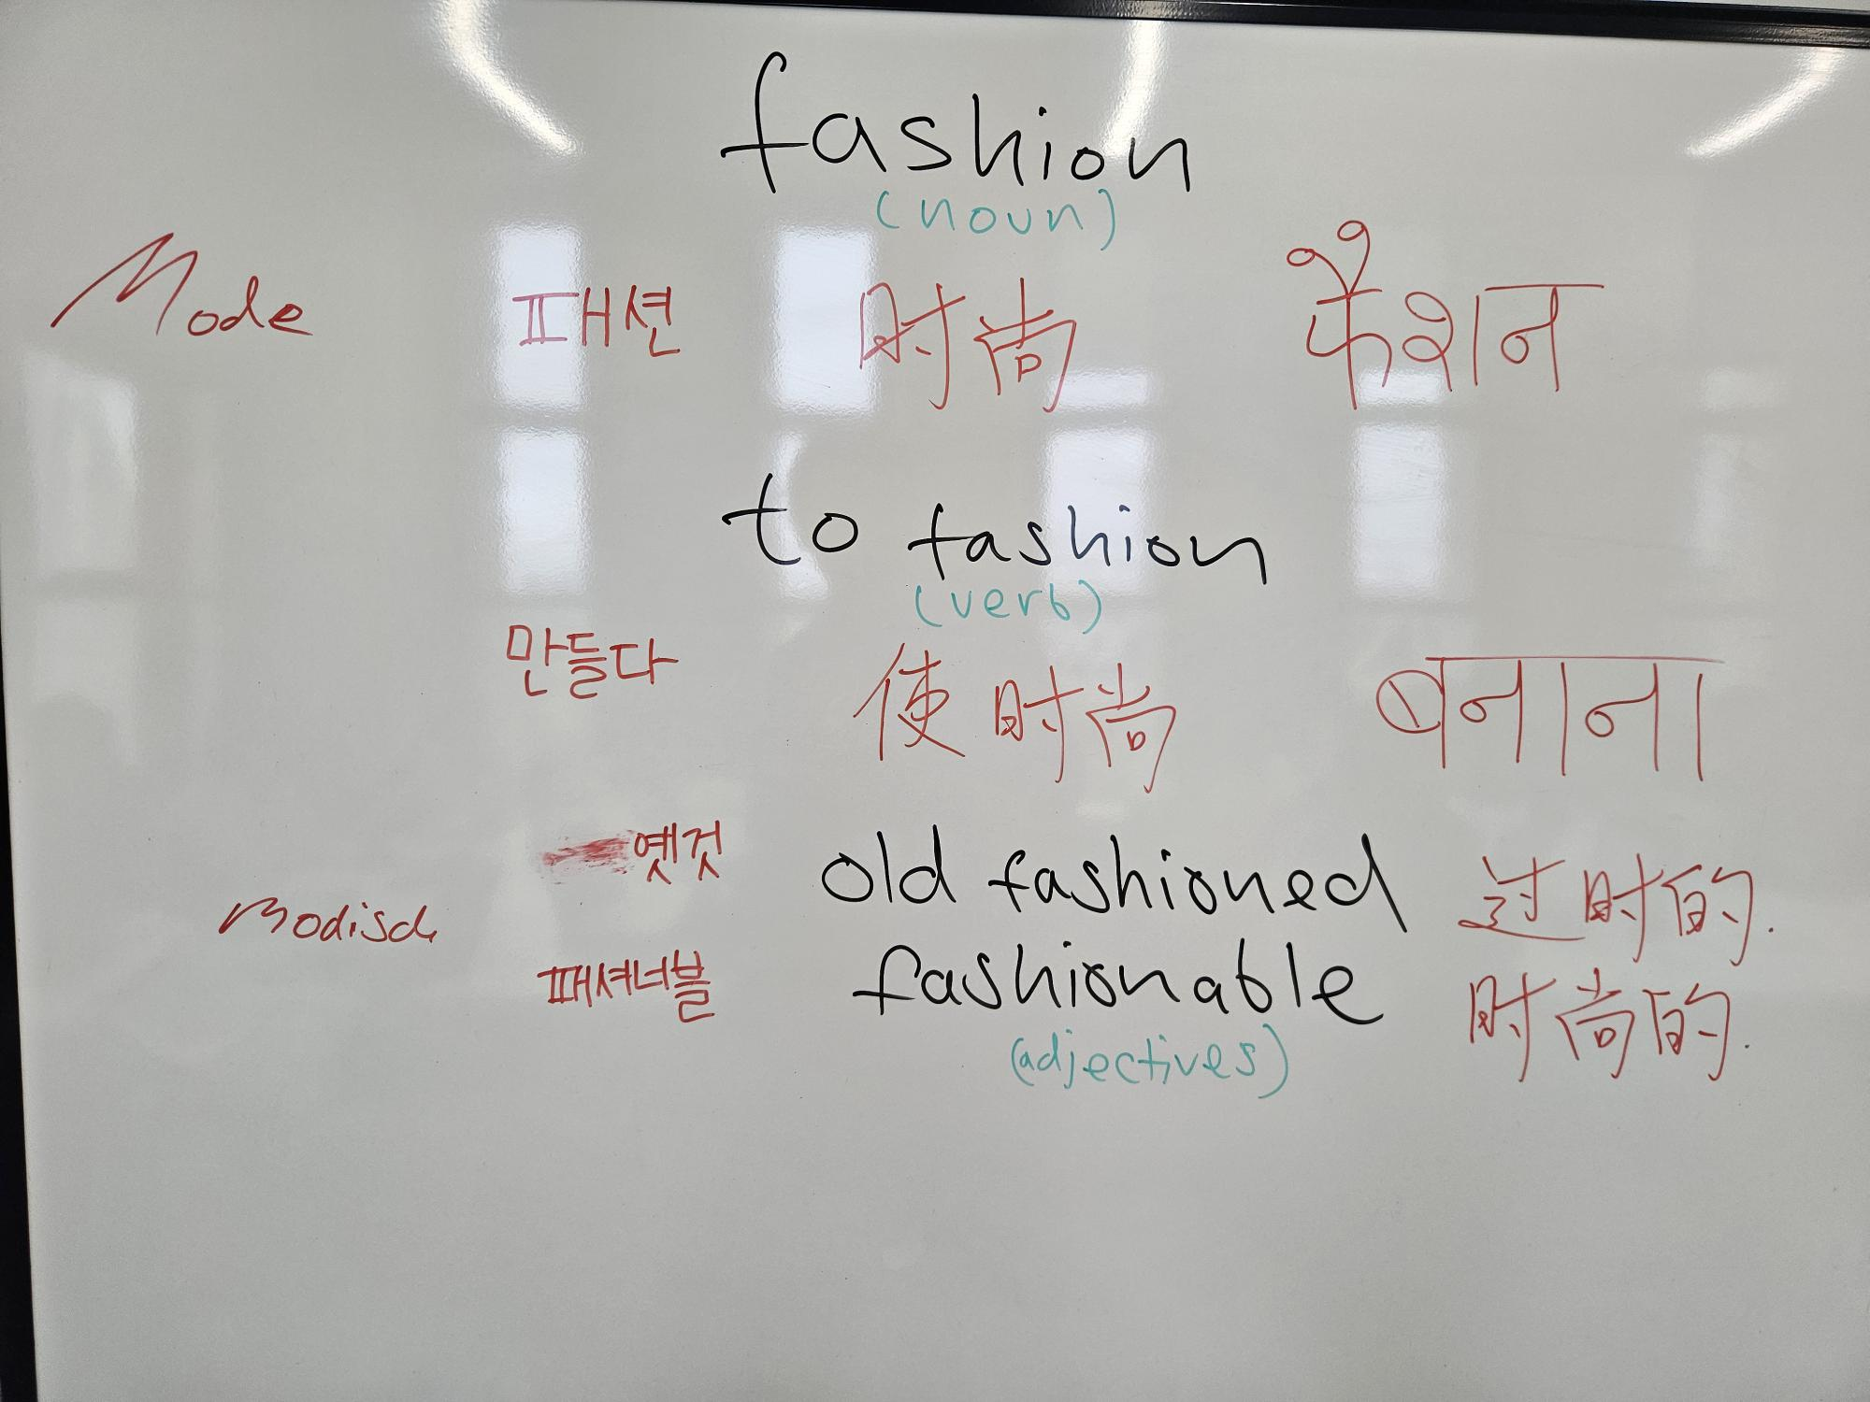
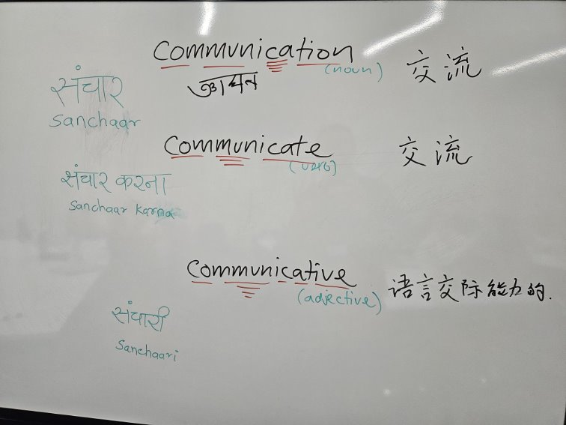
Language Development_ 5 x MA_ 1 x PG Dip_ Fashion Business School London College of Fashion_ Block One_ 2025
LO2

Slide 3

Why translanguaging?: (Assumptions)
Normative?
The multilingual backgrounds of students and tutors should be seen as a pedagogic resource and as a legitimate part of classroom and creative practice
(Odeneyi, 2022, p. 73)
A lack of worldview awareness in our first language results from ‘the fact that as we master our native tongue, it in turn masters us’
(Fantini, 1989, p. 2).
Benefits both L1 and L2 speakers
LO1

Slide 4
Social Theory, Social Semiotics and Ethics:
.
The ambitious goal of positioning language educators as agents of change calls for robust theoretical tools to analyse the broadest to the smallest of phenomena.
First, as Bhaskar argues, ‘change cannot occur unless we understand the structures that operate the events that lead to how things are’ (Bhaskar, 1989, p. 2).
Bourdieu agrees ‘we must provide causal explanations to “make trouble” and “provoke”; that is, to question received categories and unveil the doxic taken-for-granted assumptions of the social world that typically conceal power relations’ (Bourdieu, 1993).
LO1
(Monbec and Ding, 2024, p.12)

Slide 5
Research Question - a Critical Realism Frame
How do students' expressions of attitudes and feelings about participating in a multilingual translation intervention act as indicators of the underlying *habitus and *doxa that facilitate or constrain the development of a transformative and inclusive multilingual identity and learning environment?
empirical domain
actual domain –
Causal mechanisms
Long term Project aim
real domain
*'Habitus' = habits of perception, classification, appreciation, feeling, and action (Bourdieu, 1977)
*Doxa' = taken-for-granted assumptions (Bourdieu,1993)
(Adapted from Wiltshire, 2021)
LO2

Slide 6
Data sets: Post Graduate Fashion Business LCF
Qualitative interview n = 4 (female)
1 x Chinese (Mandarin) - 1 x Vietnamese - 1 x Israeli (Hebrew/ English) - 1 x British (English)
Anonymous Qualitative (+ quantitative survey) questionnaires n = 15 (by language)
5 x Chinese (Mandarin) - 1 x Chinese (Cantonese) - 1 x English - 2 x Italian – 1 x Spanish 1 x Thai
1 x Japanese - 1 x Hindi - 1 x Hindi/ English/ Gujrati - 1 x Ukrainian/ Russian
(*Both interview and questionnaires employed the same question frames)
LO3

Slide 7
How do you feel about seeing and hearing your own language in the LD classroom?
Self
Makes me feel represented.
It was very insightful!
It feels good to apply our own language to the class.
sometimes helps but not necessary to hear my language in the lessons
One language helps to understand another
I find it really interesting to see the differences between my language and the other languages
Inclusive
I feel a sense of intimacy
Samples:
survey qual questionnaires
LO4

Slide 8
How do you feel about seeing and hearing your own language in the LD classroom?
Self
I will feel happy and maybe a bit proud to see my language
Interesting reminder of how one single term - single concept can be you know, labelled with some sort of term
affective
cognitive
Samples: qual interviews –
LO4

Slide 9
How do you feel about seeing and hearing other languages in the LD classroom?
Other
Interesting to find connections between different languages
It’s interesting to see and learn different languages from other students with different backgrounds.
uncomfortable especially in a group work
It's good that other languages are included as well
I am filled with curiosity towards other languages
Samples: survey qual questionnaires
LO4

Slide 10
How do you feel about seeing and hearing other languages in the LD classroom?
I think it was really interesting to see where, like in the same way you get kind of repeating endings or chunks of words, you get repeating characters and stuff that was quite interesting.
Other
It's interesting, like it makes you feel kind of less alone - that everybody comes from a different place, and maybe the things I'm struggling with and well, you know - like the other students are also having... like challenges with them because we come from like different backgrounds, where our language is so different from English.
cognitive
affective
Samples: qual interviews –
LO4

Slide 11
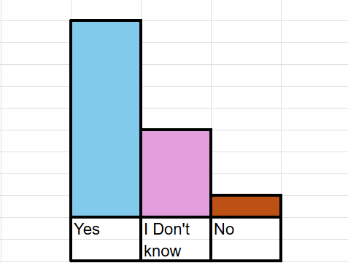
Do you think that this activity can benefit your learning?
cognitive
it may help me to, you know, express... fluently in both languages​
Quant survey
it is a reminder for me to... stop sometime to think about like what exactly that term means even in my language
I think it benefits things like the why we choose words... like deep meaning of words or connotations
it kind of just gives you a like a different way of looking at words... like in Hebrew it's called the Shoresh, which is like the foundation of the word
Samples: qual interviews
LO4

Slide 12
Themes: data reduction- causal mechanisms
Facilitation Constraint
Reflexive potential for change (from habitus)
lIlegitamate cognitive
value
Legitimate cognitive value
Discomfort
Discomfort
Interest in other
Form -Non systematic
form
culture
Other -
empathy
comfort
Paradox?
Self -
Inclusivity Identity
Affective
value
Rule orientation?
(Monbec and Ding, 2024)
causal power structures?
Resource orientation?
(Monbec and Ding, 2024)
causal power agency?
LO4
Discourse analysis – it's distinction between ‘between
the causal power of structures and the causal power of agency’ (Newman, 2020, p. 2)

Slide 13
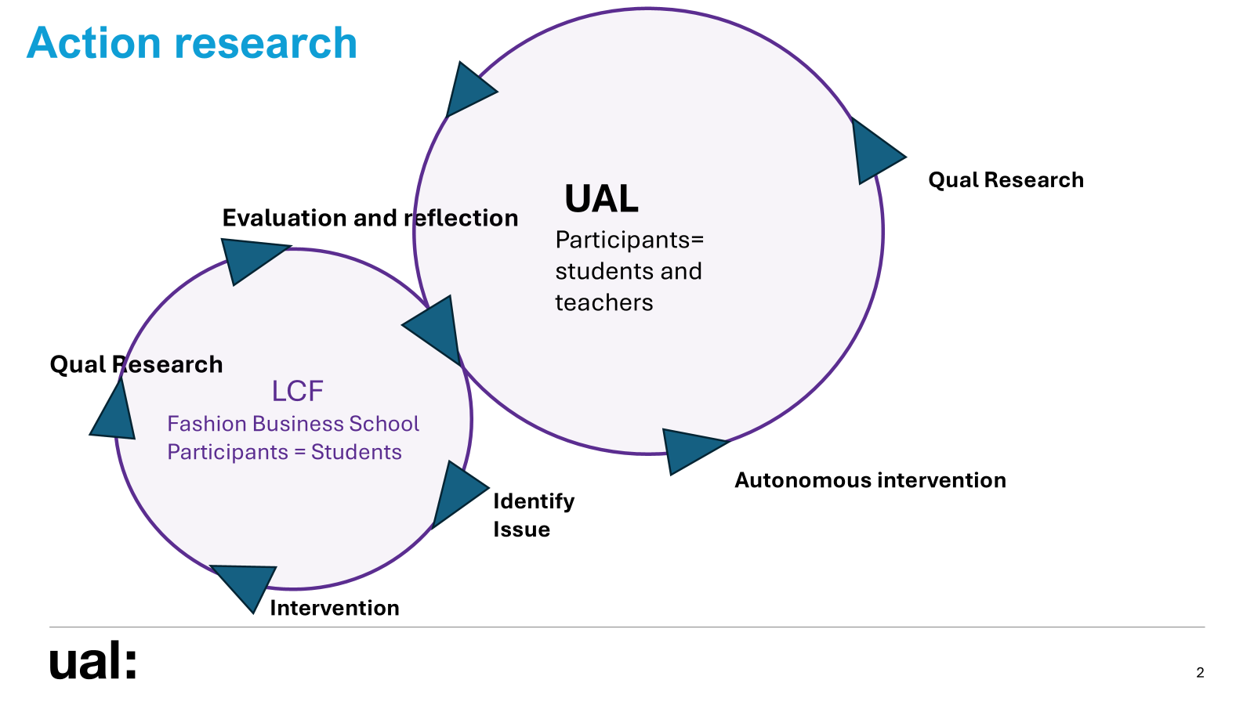
Thank you
Ian Holmes MSc BA (Hons) AFHEA
i.holmes@arts.ac.uk
LO2

Slide 14
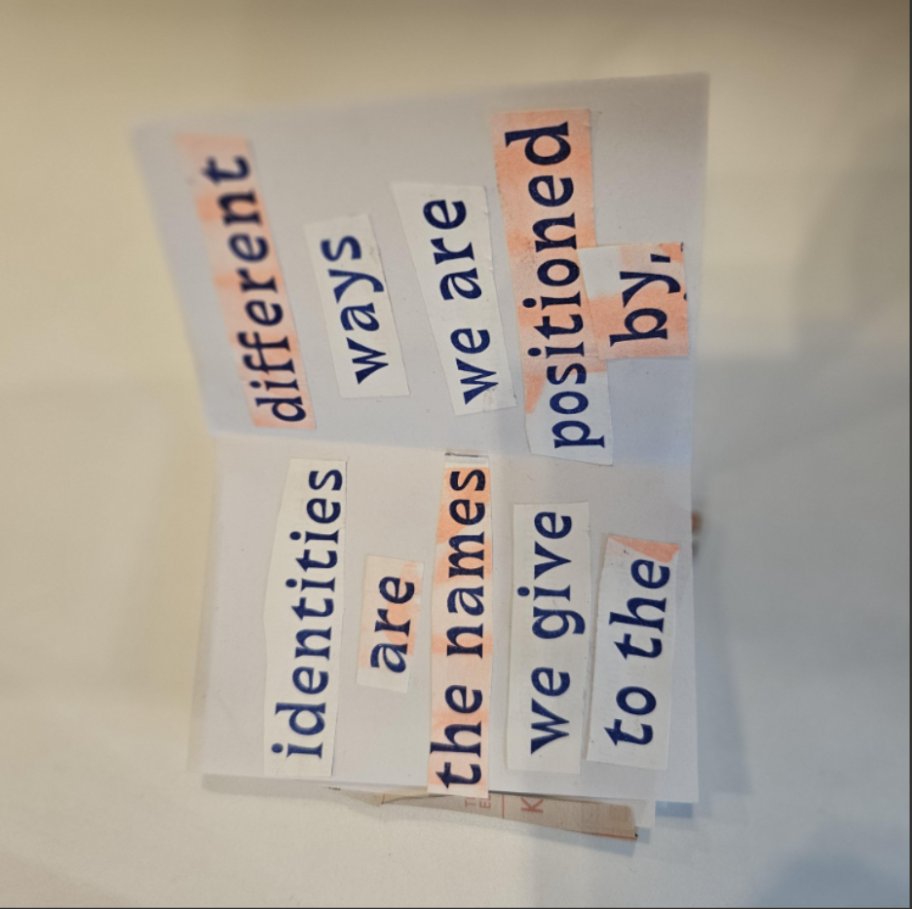
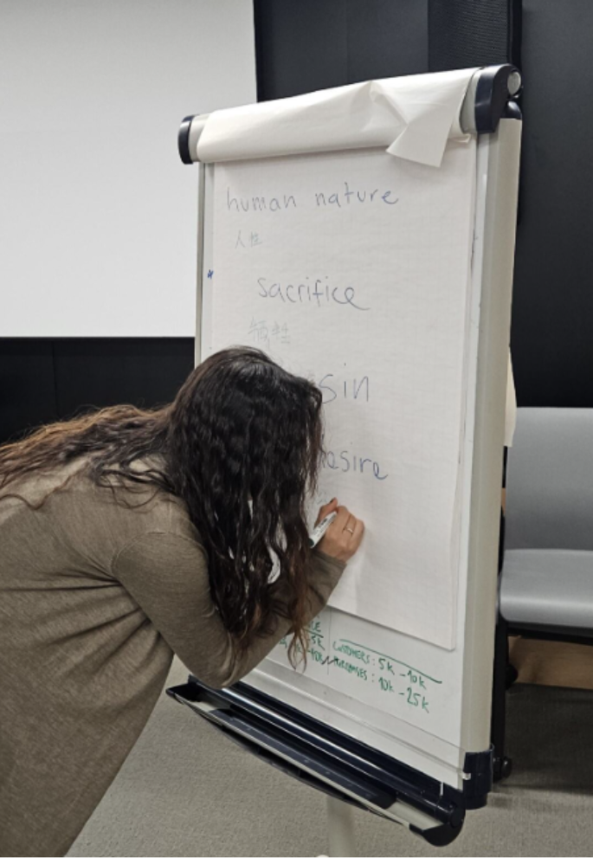
Revised Research Question – Future Cycle
How do students' and educators' expressions of attitudes and feelings about participating in a multilingual translation intervention act as indicators of the underlying *habitus and doxa that facilitate or constrain the development of a transformative and inclusive multilingual identity and learning environment?
Other related collaborative
translanguaging activity ideas:
Arts – "Translanguazines" – inspired by Adam Ramejkis's 'Zine' workshops
Fashion Business School - Translingual Global Cultures Marketing Campaign
LO2

Slide 15
References:

Slide 16
References:
Albaba, M.B. (2025) 'Proposing a linguistic repertoires perspective in multilingual higher education contexts,' Journal of Learning Development in Higher Education (36)
Bhaskar, R. (1989) Reclaiming reality: A critical introduction to contemporary philosophy. Routledge
Bhaskar, R. (2008) A Realist Theory of Science. Routledge
Bourdieu, Pierre (1977) Outline of a Theory of Practice. Cambridge University Press.
Bourdieu, P. (1993) The Field of Cultural Production: Essays on Art and Literature. Columbia University Press
Braun, V. and Clarke, V. (2020) Thematic Analysis: A Practical Guide. Sage
Chun, C. W., (2015) Power and meaning making in an EAP classroom: Engaging with the everyday. Multilingual Matters
Crouch, C., and Pearce, J. (2012) Doing research in design. Bloomsbury
Friere, P. (2005) Pedagogy of the Opressed: 30th Anniversary Edition, [Originally published 1970] Continuem

Slide 17
References
García, O. (2009). ‘Education, multilingualism and translanguaging in the 21st century.’ In: Ajit Mohanty, Minati Panda, Robert Phillipson and Tove Skutnabb-Kangas (eds). Multilingual Education for Social Justice: Globalising the local. New Delhi: Orient Blackswan, pp. 128-145
Gray, C., and Malins, J. (2007) Visualizing Research: A Guide to the Research Process in Art and Design, Taylor & Francis Group
Haim, O., and Manor, R. (2025) 'Exploring translanguaging in academic discourse through an ecological analytic lens.' International Journal of Bilingual Education and Bilingualism, 28(4), 449–464. https://doi.org/10.1080/13670050.2024.2433145
Kulkarni T., Toksha, B., and Gupta P.A. (2022) 'Applications of Artificial Intelligence in Learning Assessment' in Artificial intelligence in higher education ed. Phrashant A Gupta. DOI:10.1201/9781003184157-5
Krathwohl, D.R., Bloom, B.S., & Masia, B.B. (1964). 'Taxonomy of educational objectives: The classification of educational goals.' Handbook II: Affective domain. David McKay Co.
Krathwohl, D.R. (2002) ‘A Revision of Bloom’s Taxonomy: An Overview’ Theory Into Practice, Vol. 41 (4), pp. 212-218 Available at: https://www.jstor.org/stable/1477405 (Accessed 11 February, 2025)

Slide 18
References
Monbec, L. and Ding, A. (2024) Recovering Language in Higher Education Social Justice, Ethics and Practices. Palgrave Macmillan
Newman, J. (2020) ‘Critical realism, critical discourse analysis, and the morphogenetic approach.’ Journal of Critical Realism, 19 (5) pp. 433- 455.
Odeneyi, V. (2022) ‘Reimagining Conversations,’ Available at: https://www.arts.ac.uk/__data/assets/pdf_file/0032/359339/Reimagining-Conversations_FINAL.pdf (Accessed on 26.09.2025)
Porto, M., and Zembylas, M. (2020) Pedagogies of discomfort in foreign language education: cultivating empathy and solidarity using art and literature,' Language and Intercultural Communication, 20(4), 356–374. https://doi.org/10.1080/14708477.2020.1740244
Saunders, M.N.K., Thornhill, P., and Lewis, A. (2023) Research methods for business students: Ninth ed. Pearson
Shepherd, K. (2007) ‘Higher education for sustainability: seeking affective learning outcomes,’ International Journal of Sustainability in Higher Education Vol. 9 (1), pp. 87-98 DOI 10.1108/1467637081084220

Slide 19
References
Smeenk, W., Mayer, C., and James, E. (2025) 'The Empathy Compass for addressing Societal Challenges in Education. A tool for higher education to stimulate, facilitate and assess empathic awareness in multistakeholder collaborations,' Higher Education Research & Development pp. 1-19
https://doi.org/10.1080/07294360.2025.2510670
Tesch, R. (1990) Qualitative Research: Analysis Types and Software Tools, pp. 77–111 Falmer
Widdowson, H.E. (1983) Learning Purpose and Language Use. Oxford University Press
Zembylas, M. (2024) 'Affect, race, and white discomfort in schooling: Decolonial strategies for ‘pedagogies of discomfort’,' in Critical philosophy in race and education. Routledge
Zhang, H. (2021) 'Translanguaging space and classroom climate created by teacher’s emotional scaffolding and students’ emotional curves about EFL learning,' International Journal of Multilingualism. DOI: 10.1080/14790718.2021.2011893

Slide 20
Thank you to
Tim Williams
Julie Dennison,
Jo Onno,
Zoi Zoupanou,
Sophia Di Piazza
The LCF Fashion Business School, all the critical friends on the 2025-26 PG Cert and all the student participants in the study.
Ian Holmes MSc BA (Hons) AFHEA i.holmes@arts.ac.uk

Slide 21
APPENDIX*Extra slides for discussion – ad hoc:
(Reference List above also contains sources cited here)

Slide 22
'The EAP classroom is a site of power, agency and multiple meaning makings'
(Chun, 2015, p. 2)

Slide 23
Two broad ontologies:
Language as rule vs language as resource
(Monbec and Ding, 2024)

Slide 24
Two paradigms: product (training) vs process (education)
(Widdowson, 1983)

Slide 25
Why translanguaging?: (Assumptions)
Translanguaging optimizes the potential for communication through accessing different linguistic features of ‘autonomous languages’ (Garcia, 2009, p.140).
By recognising linguistic diversity as an asset, educators can enhance cognitive engagement, foster inclusivity, and contribute to decolonising academic spaces (Albaba, 2025, p. 4)
‘Linguistic determinism’ is the system through which we understand and mediate the world, being exposed to a second language may expand this view and aid participation with other cultural groups (Ibid, pp.23).

Slide 26
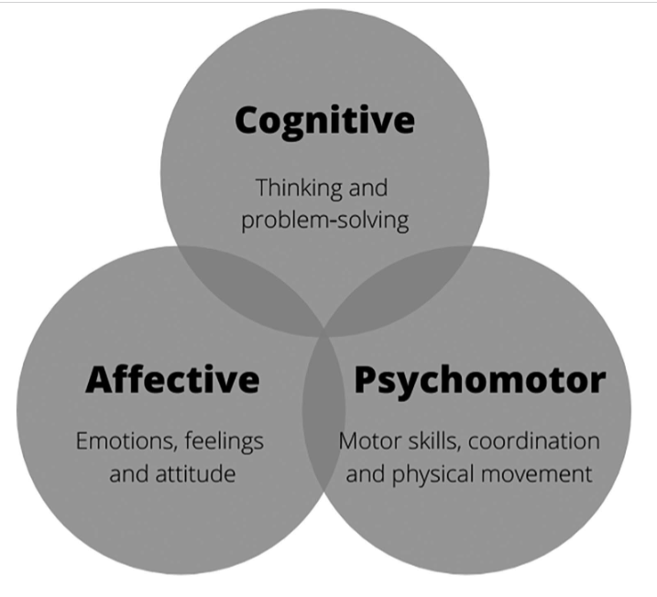
Learning Domains in HE:
Teaching and assessment in HE has traditionally focused on the cognitive rather than the affective (Shepherd, 2007)
(Bloom et al., 1956)
(Anderson and Krathwohl, 2001; Krathwohl, 2002; Krathwohl, Bloom and Masia,1964)
Three Major Domains of Learning as Cognitive, Affective and Psychomotor, with Their Features
(Kulkarni,Toksha and Gupta 2022, p.3)

Slide 27
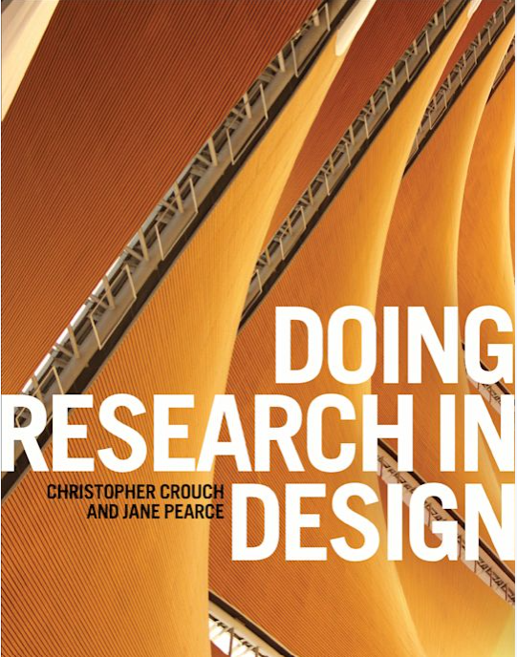
‘social processes cannot be directly discovered’
Purpose of research =
‘understand those processes through the use an interpretivist lens.’
However, assuming that the ‘world is characterized by inequalities’ the role of the researcher is to ‘explore and attempt to expose’ those inequalities through use of a
Critical lens
to develop -
‘participatory action research’ to provoke change
(Crouch and Pearce, 2015, pp. 59 – 63)

Slide 28
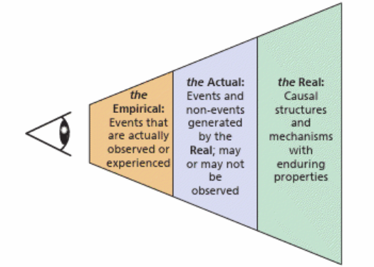
Critical Realism Frame - in EAP
Critical realists stratified ontology. (Bhaskar, 2008; Saunders, Lewis and Thornhill, 2023, p. 149)
Discourse analysis – it's distinction between ‘between the causal power of structures and the causal power of agency’ (Newman, 2020, p. 2)
empirical domain
actual domain –
Causal mechanisms
real domain
(Adapted from Wiltshire, 2021)

Slide 29

‘Researcher subjectivity – is an integral part of the analysis’
‘The researcher becomes the instrument for analysis’
(Braun and Clarke, 2020, p. 60)
I am positioned more centrally in the process
I must be explicit about my ideology relative to the design of my intervention
(Crouch and Pearce, 2015,p. 62).

Slide 30
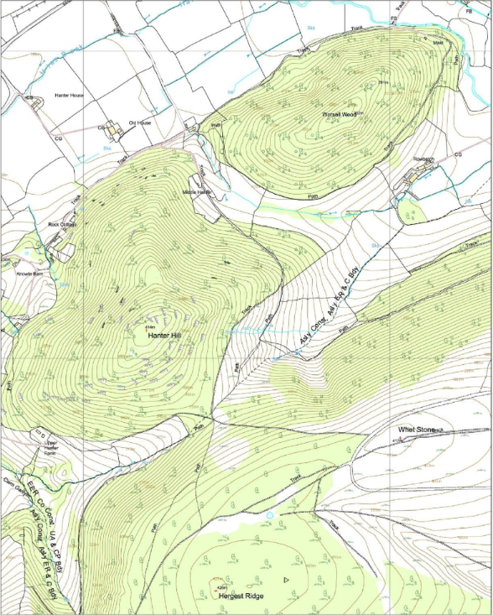
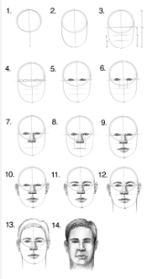
'Qualitative research is to a large degree an art...
…data ‘reduction’...
...a representation in the same sense that an artist can …
… create an image of a face that we would recognise if we saw the original in a crowd'
Interpreting the map
(Tesch, 1990, p. 304 in Gray and Malins 2007, p. 130)

Slide 31
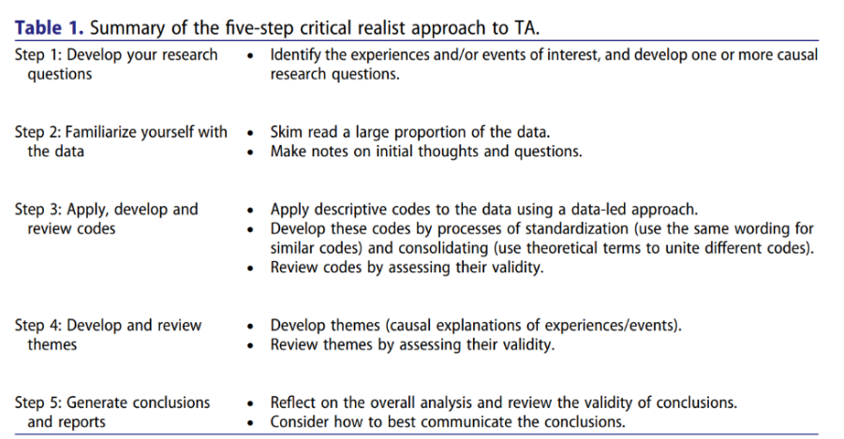
Thematic Analysis – A Critical Realist Approach
Fryer (2022, p. 366) offers a critical realist approach to Thematic Analysis that is appropriate for this project which ultimately ‘seeks to develop causal explanations.’
Compatible with Braun and Clarke (2020)
Familiarization with the Data
Generating Initial Codes
Searching for Themes
Reviewing Themes
Defining and Naming Themes
Writing the Report
Critical realism aspect

Slide 32
Implications- comfort/ discomfort: Affective – cognitive
Whilst a pedagogy of discomfort is more explicitly focussed on the 'pedagogisation of white discomfort within the broader decolonising project' (Zembylas, 2020), language teaching can and should also explicitly aim to sensitise students about issues of human suffering and cultivate empathy, solidarity, hospitality and inclusion (Porto and Zembylas, 2020).
Exposure to diverse perspectives encourages individuals, particularly students, to expand their empathy by challenging their preconceptions, fostering understanding, and promoting a deeper sense of interconnectedness with others (Smeenk, Mayer, and James, 2025).
Translanguaging pedagogy is associated with aspects of identity affirmation, equity, equality, and decolonialization' allowing students 'to construct and negotiate meanings' (Haim and Manor, 2024).

Slide 33
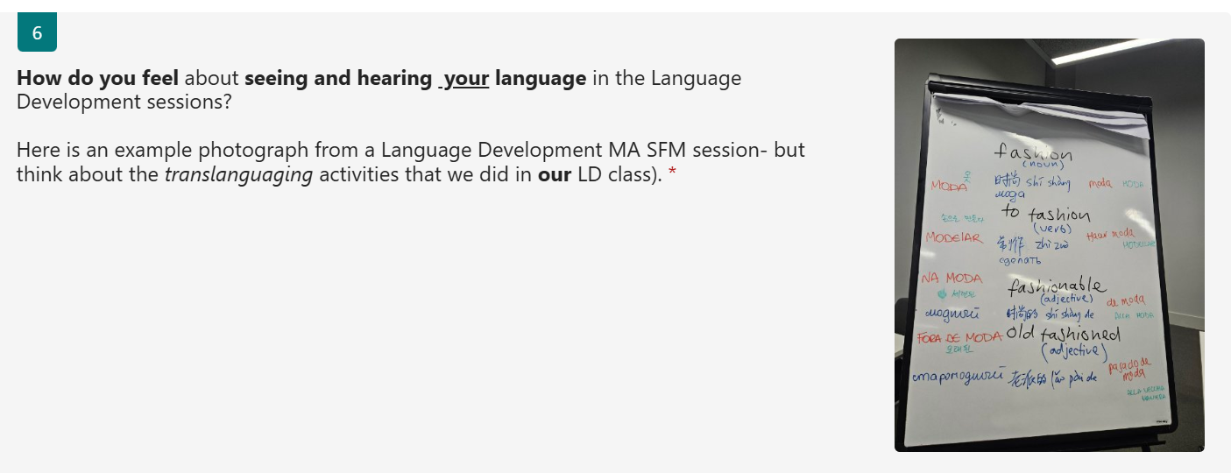
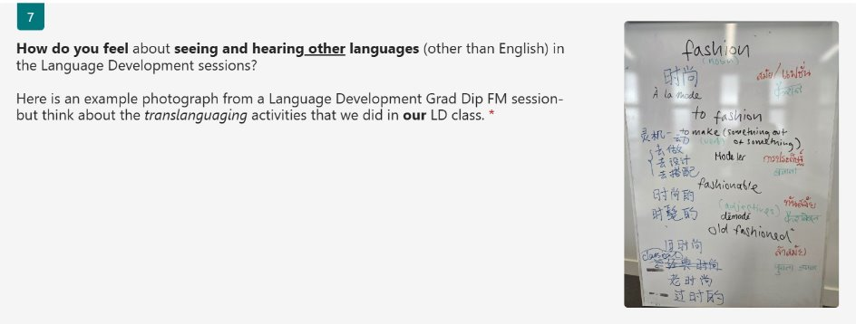
Core Qualitative Questions - Affective
Documenting and scaffolding students’ emotions close the distance between teachers and students... activate students’ reflective and affective ability... to communicate.... in a translanguaging space
(Zhang, 2021, p. 23)
Self
Other

Slide 34
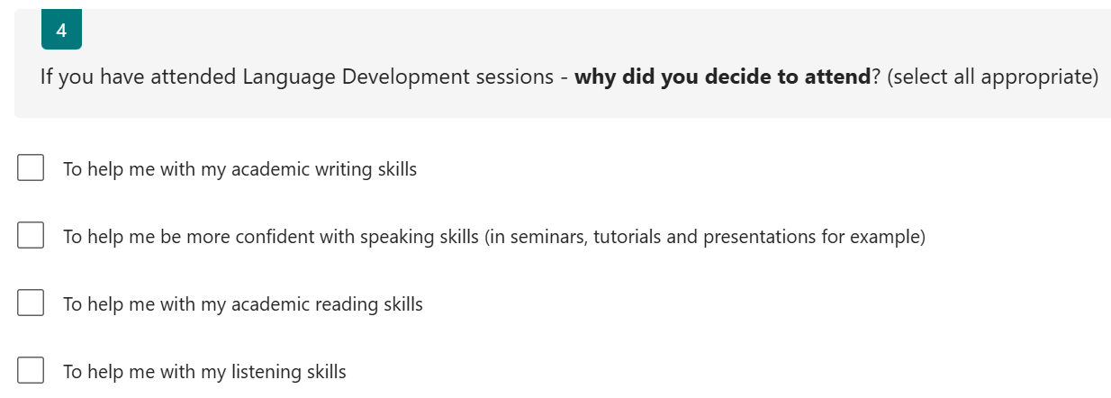
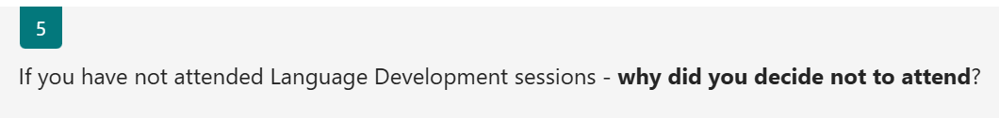
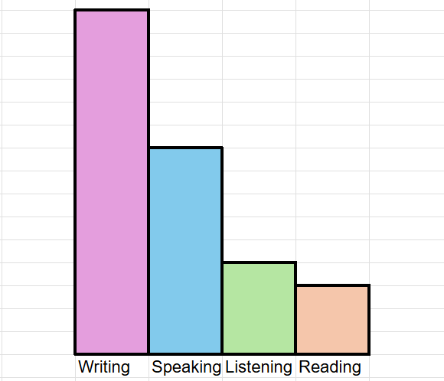
There are some other arrangements that conflict with this time
I prefer online class of this language class, like Graduate Diploma in 2023.
its always scheduled at 9 am so it becomes a little difficult to reach on time.
Because I did not find some of the content relevant for me and would rather use that time to work on my assignments, sorry!
because i believe i can pass the language exam by myself.😄
I would like to have more specific content related to assignment (not based on broad topic but more specificaly relate to writing content)​
if the number of students in the class is small, it would be helpful for me to do Q and A or something like more personal things
Samples
survey qual questionnaires
Quant/Qual data in survey (n = 15) Attendance vs non-attendance to LD

Slide 35
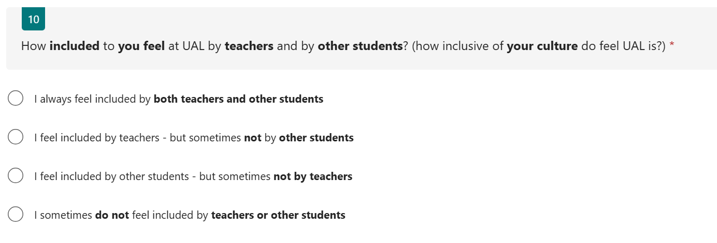
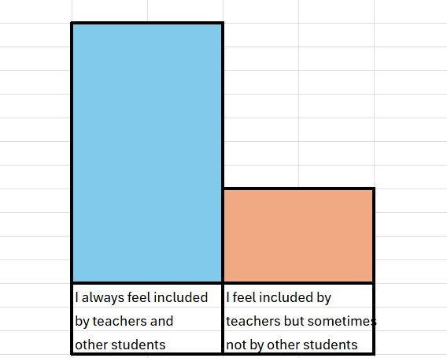
Quant data survey (n = 15) inclusivity
… definitely feel included because I feel like Chinese students account for a very large number
s
Yeah, I feel included by both teachers and students
I saw on a board - like a big board, saying welcome to people everyone. ​
Every student in different languages but I don't see my language- Vietnamese​
​
I
.
I do feel like the course itself sometimes because it's such an international cohort like is not maybe targeted towards me
Samples: qual interviews –

Slide 36
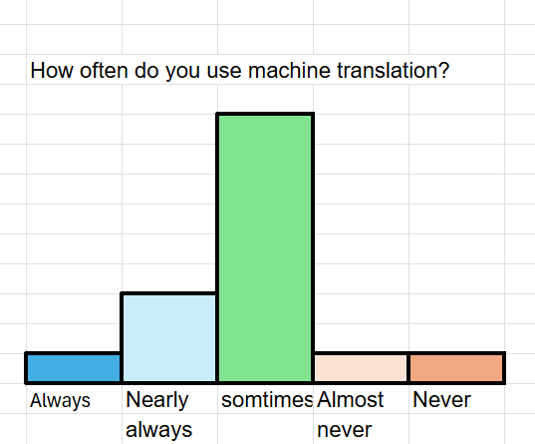
Quant Data in survey (n= 15) Machine Translation

Slide 37
Thank you to
Tim Williams
Julie Dennison,
Jo Onno,
Zoi Zoupanou,
Sophia Di Piazza
The LCF Fashion Business School, all the critical friends on the 2025-26 PG Cert and all the student participants in the study.
Ian Holmes MSc BA (Hons) AFHEA i.holmes@arts.ac.uk

